Slide 1

Student Loan Prediction and
Repayment Risk
What are the potential risks associated
with student debt and what are the best
methods of mitigation?
Team Name: Los Datos
Team Members: Alfredo Antolinez | Misti Stevens | Omar Waller

Slide 2
Introduction
Issues with student loans and financial aid touch nearly every college applicant across the nation. Tuition has increased exponentially over the last 50 years. This project is interesting because we hope to predict several key indicators like Overall Outstanding Principal Balance and Overall Repayment Rate for schools provided in the dataset. Additionally, we hope to predict student loan debt given indicators like the parent’s adjusted gross income (AGI) or an independent student’s AGI when applying to college.

Slide 3
Goals
Classify the risk of borrowing student loans at various post-secondary schools
Determine predictive reasoning capabilities of provided attribute data for determining the likelihood of student loan repayment
Create a model to predict the borrowing risk associated with attending a particular school

Slide 4
Data Set
Produced by Federal Student Aid, an office of the U.S. Department of Education
Includes populations of undergraduate, graduate and parent borrowers
Defines respective loan borrowed amounts and repayments for each population

Slide 5
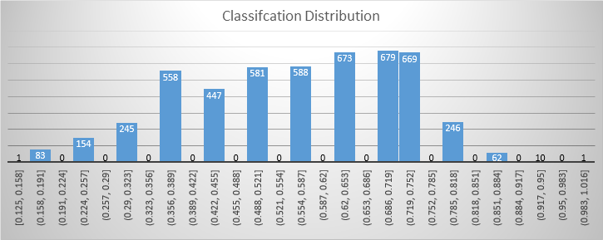
Borrowing Risk Classification Progress
Classify risk of borrowing student loans at various post-secondary schools
Quartile | Value | Type | School Count
0 | 0.125 | No Risk | 1
1 | 0.438 | Less Risk | 1487
2 | 0.563 | Moderate Risk | 1169
3 | 0.688 | More Risk | 1352
4 | 1 | Most Risk | 988

Slide 6
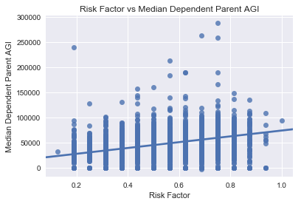
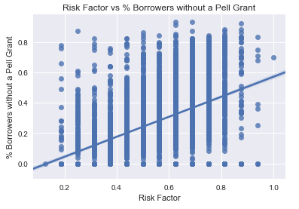
Predictive Reasoning Analysis Progress
Correlation
Risk Factor has a moderate positive correlation with:
Median Dependent Parent AGI
R-Value = 0.39
% Borrowers without a Pell Grant
R-Value = 0.47

Slide 7
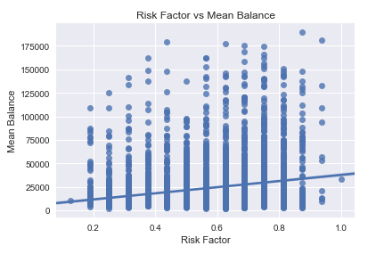
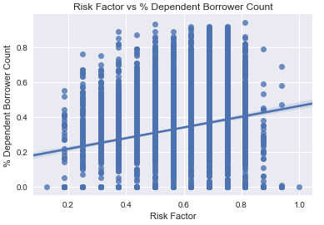
Predictive Reasoning Analysis Progress
Correlation
Risk Factor has a very weak positive correlation with:
% Dependent Borrower Count
R-Value = 0.21
Mean Balance
R-Value = 0.22

Slide 8
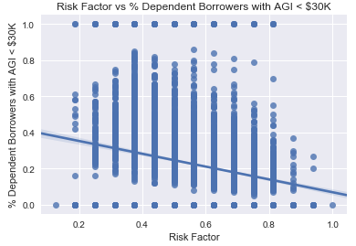
Predictive Reasoning Analysis Progress
Correlation
Risk Factor has a very weak negative correlation with:
% Dependent Borrowers with AGI < $30k
R-Value = -0.25

Slide 9
Predictive Reasoning Analysis Progress
Association
Association rules were generated for Borrowing Risk and the non-numerical attributes
Rules with Eligibility for aid and certification alongside borrowing risk were found to be strong association rules with negative and positive correlation
The association rules with type and control attribute were found to be not strongly associated to borrowing risk.

Slide 10
Future Work
Further analyze association rules generated.
Implement predictive model

